Slide 1

Android O (8.0)
What you should know
Youssef Keyrouz

Slide 2
WHAT WILL CHANGE IN ANDROID O
PUTTING THE O IN OMG
Background services
Background Location
Implicit Broadcasts
Other

Slide 3
SHOULD I PANIC?
NOT YET…. BUT
2017-2018 will feature disproportionate number of “power users”
Rumor: Android O will have a faster rollout from the big players (Samsung)
No need to target it ….. yet

Slide 4
BACKGROUND SERVICES
WHY WE CAN’T HAVE NICE THINGS
Limited to "several minutes"... where "several" seems to be one
After that, service will be stopped, akin to stopService()
Will no longer work if the app was never in the foreground (e.g., ACTION_BOOT_COMPLETED)
Ping-Pong cheating will not work

Slide 5
BACKGROUND SERVICES
THE WORKAROUNDS
Target SDK < 26 … BUT…
Foreground service
JobIntentService

Slide 6
JOB INTENT SERVICE
BEING A GOOD NEIGHBOR
Android < 8.0 Acts like an IntentService. Android 8.0+ uses JobScheduler
Added to the Support Library 26.0
Gives you a larger window for work (10 minutes)

Slide 7
BACKGROUND LOCATION
WHERE ARE YOU?
While app is in the background, location updates will be sporadic
Continuous location updates probably requires a foreground service

Slide 8
IMPLICIT BROADCAST
EVERYONE WANTS TO LISTEN
Can no longer receive implicit broadcasts via manifest-registered receivers
Massive system broadcasts Limitations (e.g. ACTION_BATTERY_CHANGED)
Some system broadcasts are white-listed.

Slide 9
IMPLICIT BROADCAST
THE WORKAROUNDS
Target SDK < 26 … BUT…
Explicit Broadcast (will require change on the sender)
If internal to your app, use event bus
Foreground Services / JobScheduler (Polling or Job Criteria)

Slide 10
MISC CHANGES
AKA CHANGES ON LESS POPULAR FEATURES
Can now request install/delete package permission
Floating windows can no longer overlay “system windows” (e.g. IME). User will be able to block these windows.
ANDROID_ID: Now per-user/per-app. (Old apps will change on reinstall)

Slide 11
WHAT O USERS WILL EXPECT
TL;DR: not much
Notification channels
Autofill
A unicorn that does their laundry

Slide 12
NOTIFICATION CHANNELS
I ALWAYS WANTED A PURPLE LIGHT
User can configure notifications (light, vibration, lockscreen, etc…) on a channel basis
Send notification through a channel. (Default channel used for older targets)
Define Channels on first run. Cannot be modified. (Can also define notification groups, for multi-user apps).

Slide 13
AUTOFILL
THE GOOD
Equivalent to the AutoFill feature in Web browsers
Pluggable autofill service providers, configured in Settings
Apply autofill hints to fields that match specific roles (e.g, username, password, credit card number)

Slide 14
AUTOFILL
THE BAD
Autofill security is contingent upon well-written autofill service providers
Possible to leak private data to malicious apps
Limited if autofill service is well-written
Very simple if autofill service sucks

Slide 15
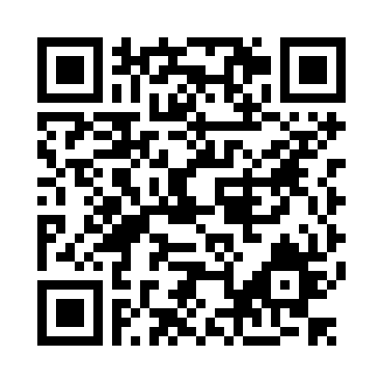
QUESTIONS?
https://github.com/YoussefKeyrouz/Presentation-Samples-Android-O
Youssef Keyrouz

